Slide 1


Slide 2
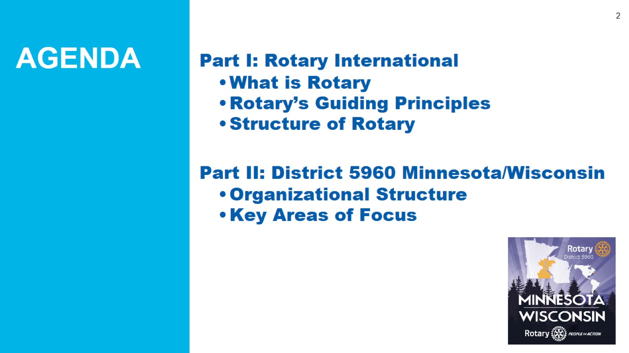

Slide 3
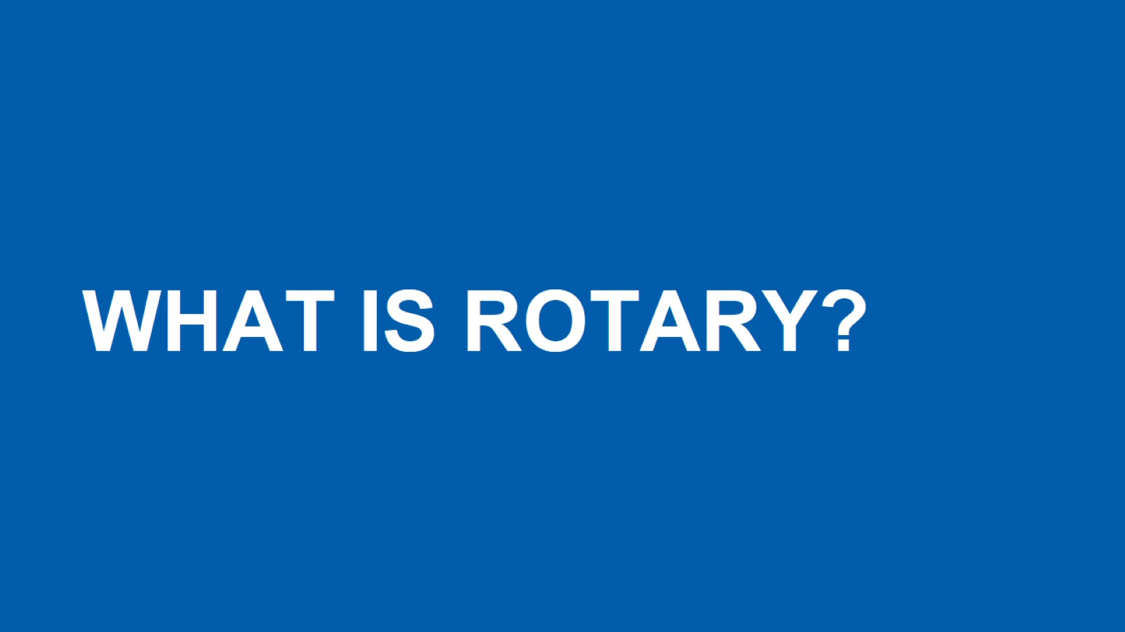

Slide 4
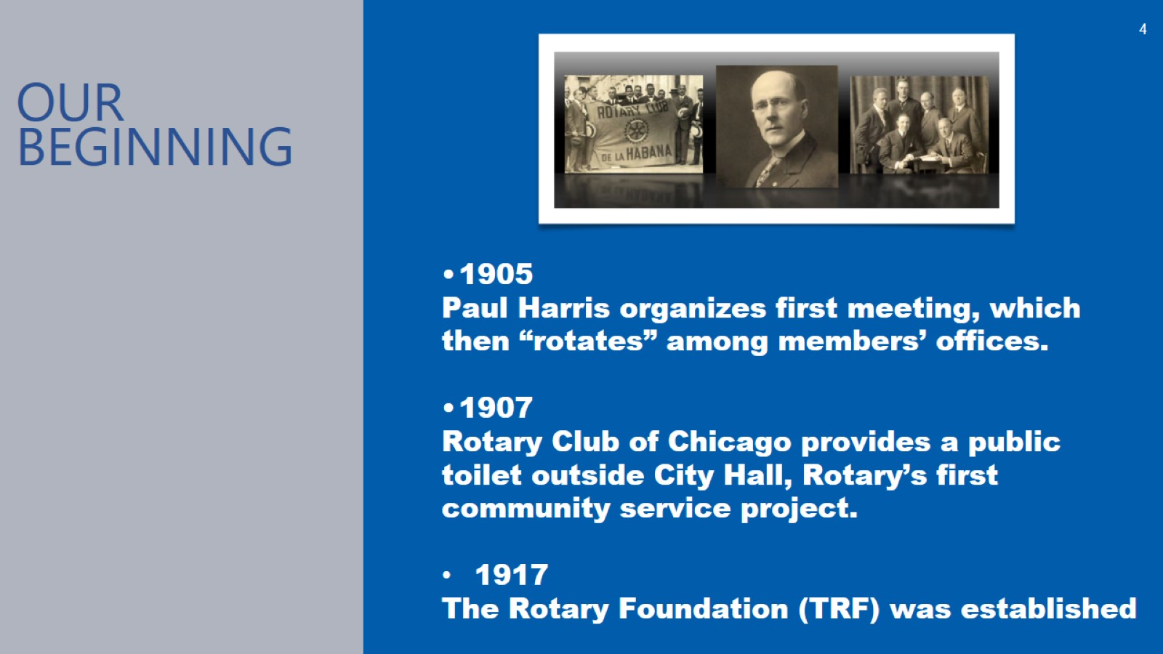

Slide 5
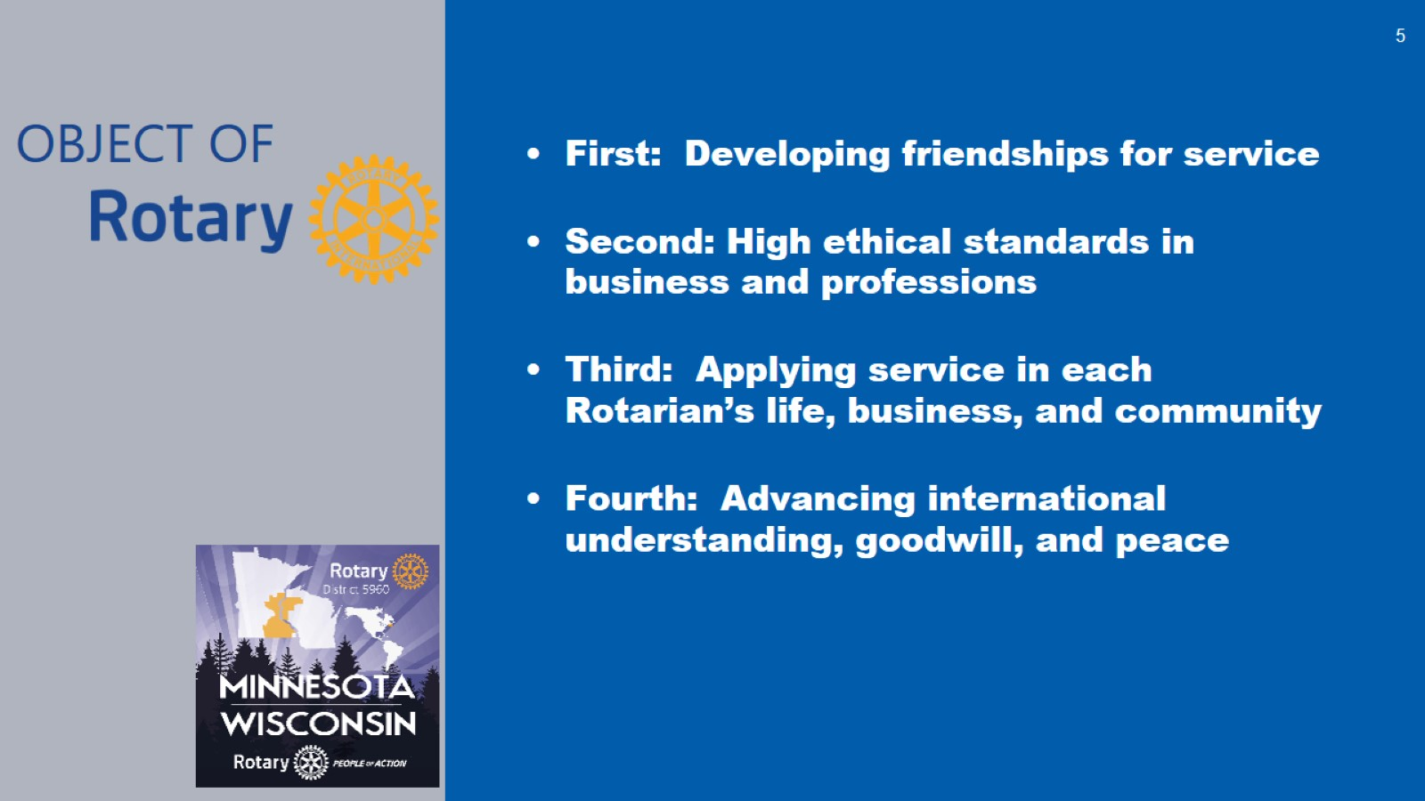

Slide 6
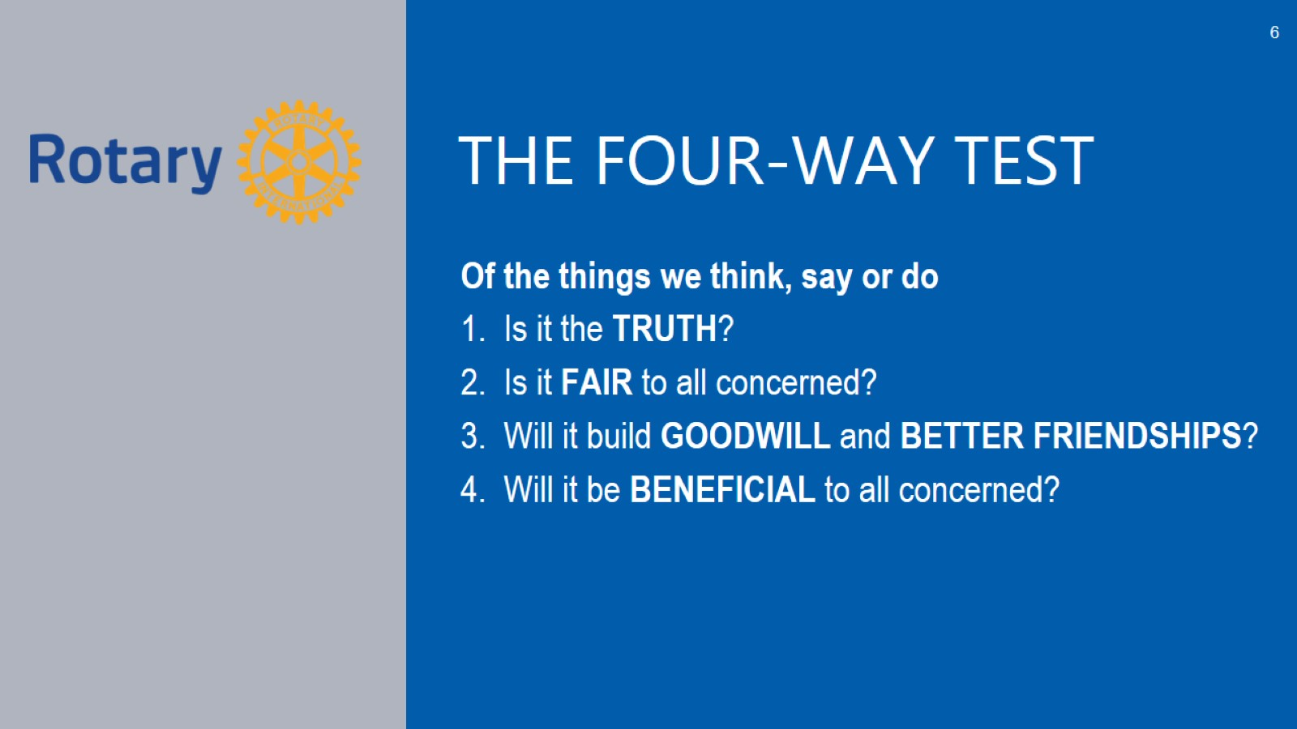

Slide 7
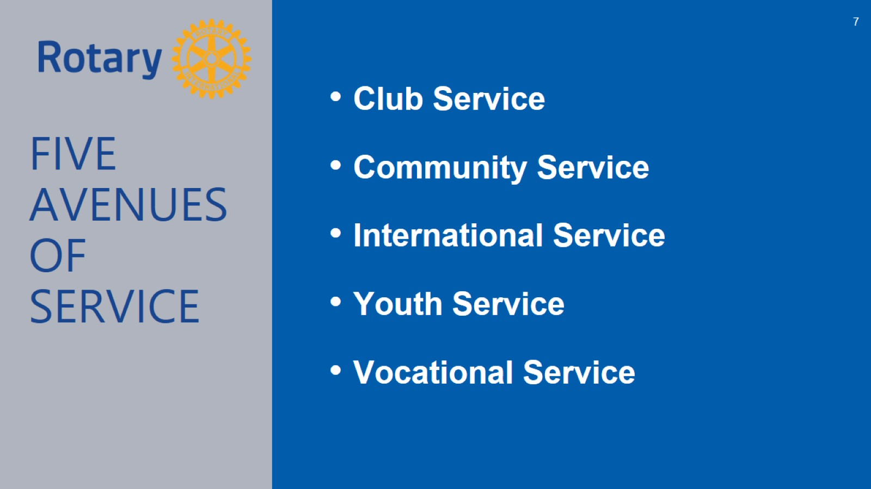

Slide 8

Rotary International/
The Rotary Foundation
535 Districts
35,000 + Rotary Clubs
10,700 Rotaract Clubs
20,300 Interact Clubs
1.2 Million Individual Members
Structure
Rotary International is governed by a board of Directors composed of the international president, the president-elect, the general secretary, and 17 zone directors.
Notes:
3.1.2021
Slide 10 Rotary Structure
(of 3.1.2021) Rotary is a grassroots organization that is built from the base of 1.2 million Rotarians who have formed over 35,000 Rotary Clubs 10,700 Rotaract Clubs, and 20,300 Interact Clubs
The Rotary Foundation operates under a separate Board of Trustees and is a 501 c3.

Slide 9
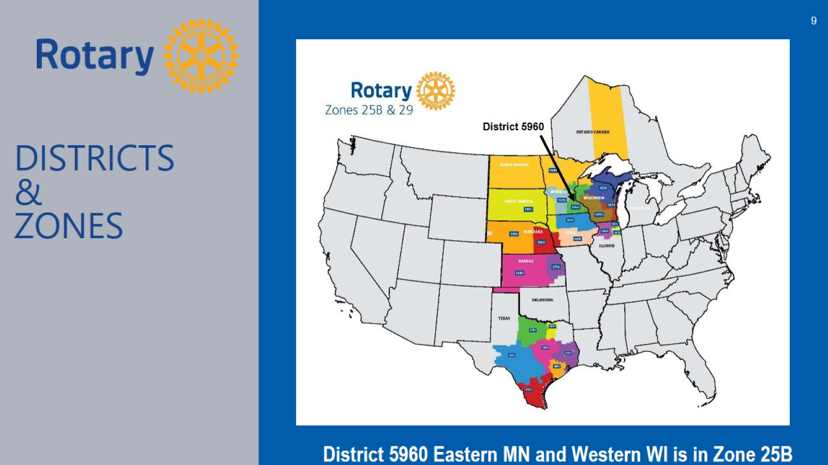

Slide 10
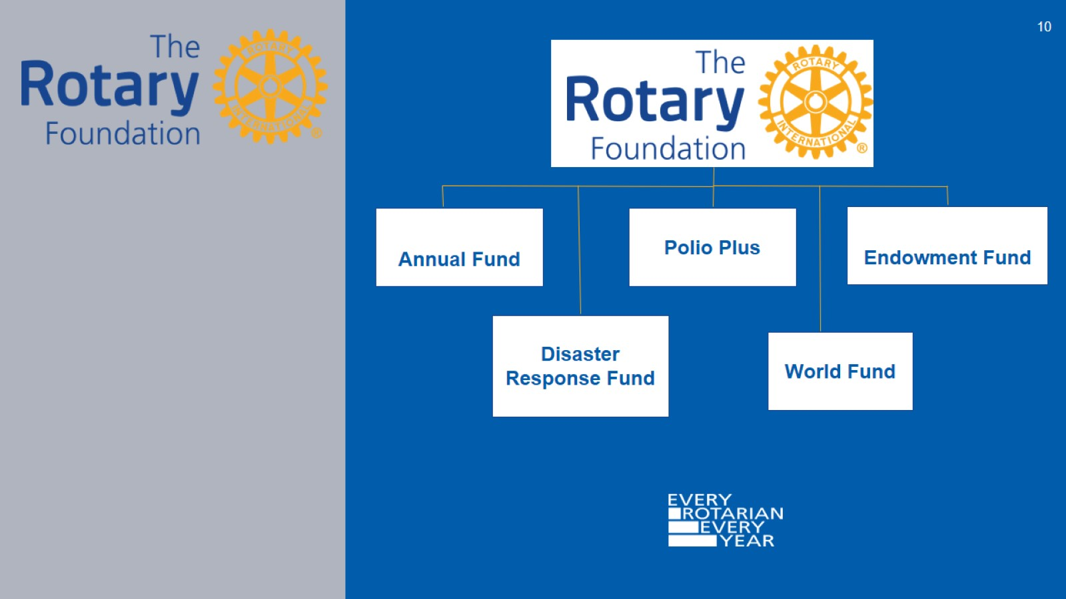

Slide 11
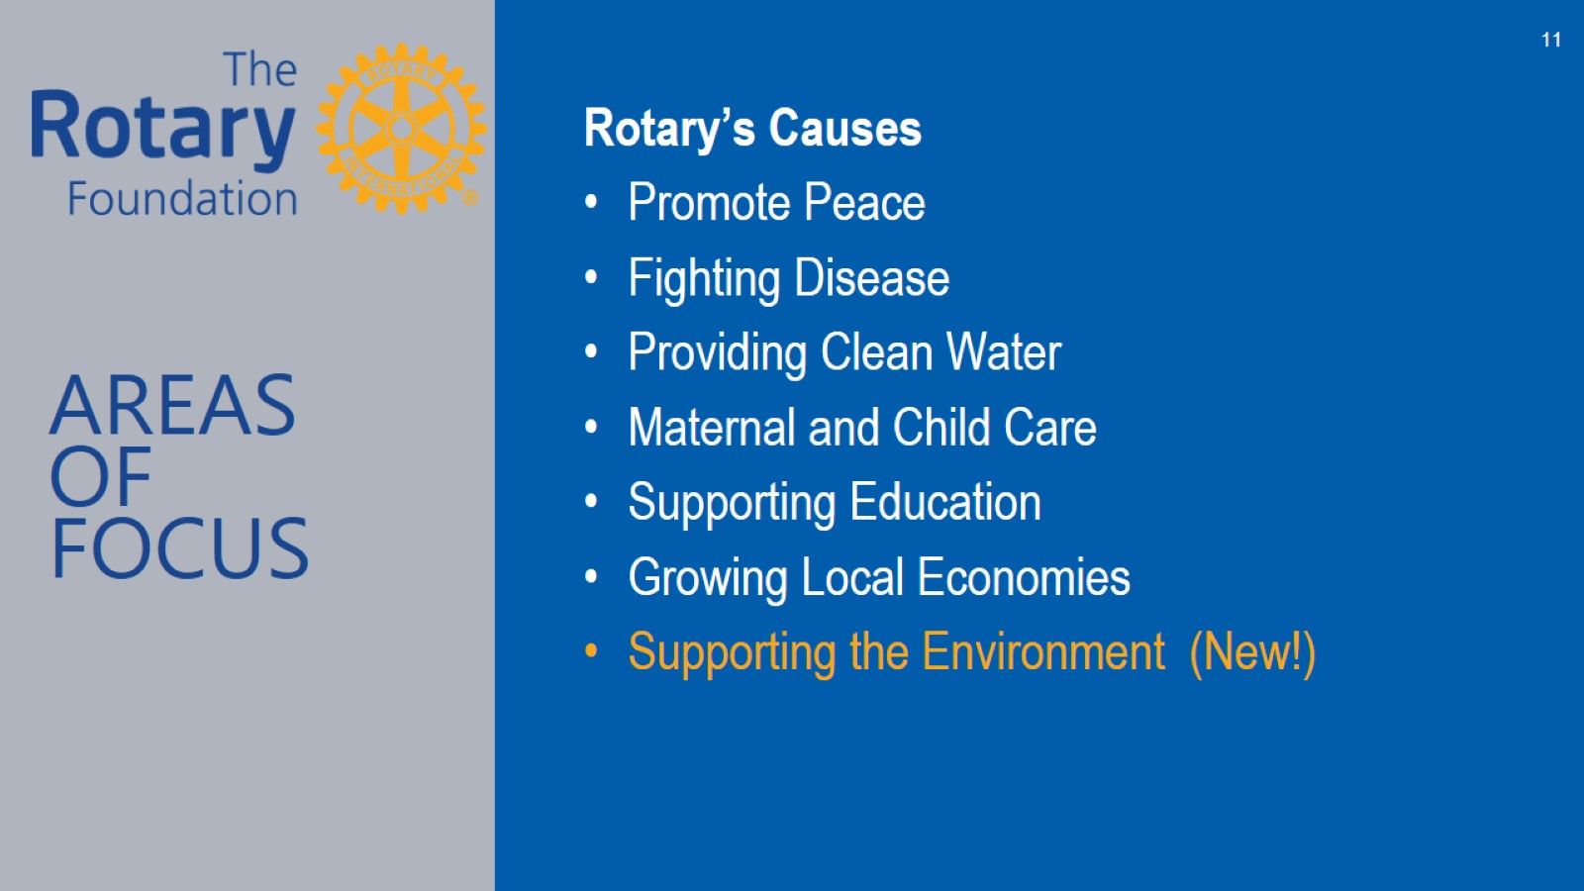

Slide 12
Responsibilities of a rotarian
Engagement
Service
Mentoring other members
Support The Rotary Foundation
Don’t just attend Rotary meetings, become a Rotarian by participating and contributing!
Establish a MyRotary account
Membership
Notes:
3.1.21
Slide 14: Responsibilities of a Rotarian
In addition to the list of responsibilities featured on this slide, we hope you know that we are counting on you to continue to grow our Rotary World by introducing others to Rotary and recruiting them to join our great organization.

Slide 13
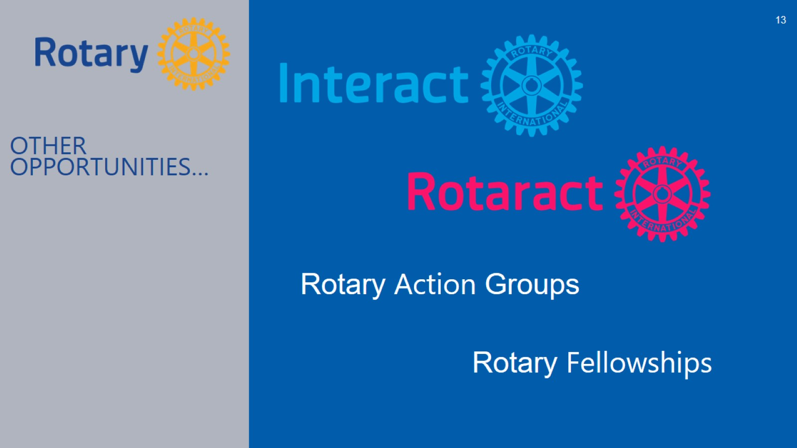

Slide 14
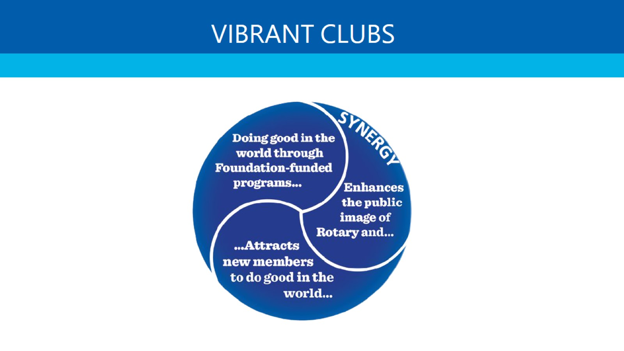

Slide 15


Slide 16


Slide 17
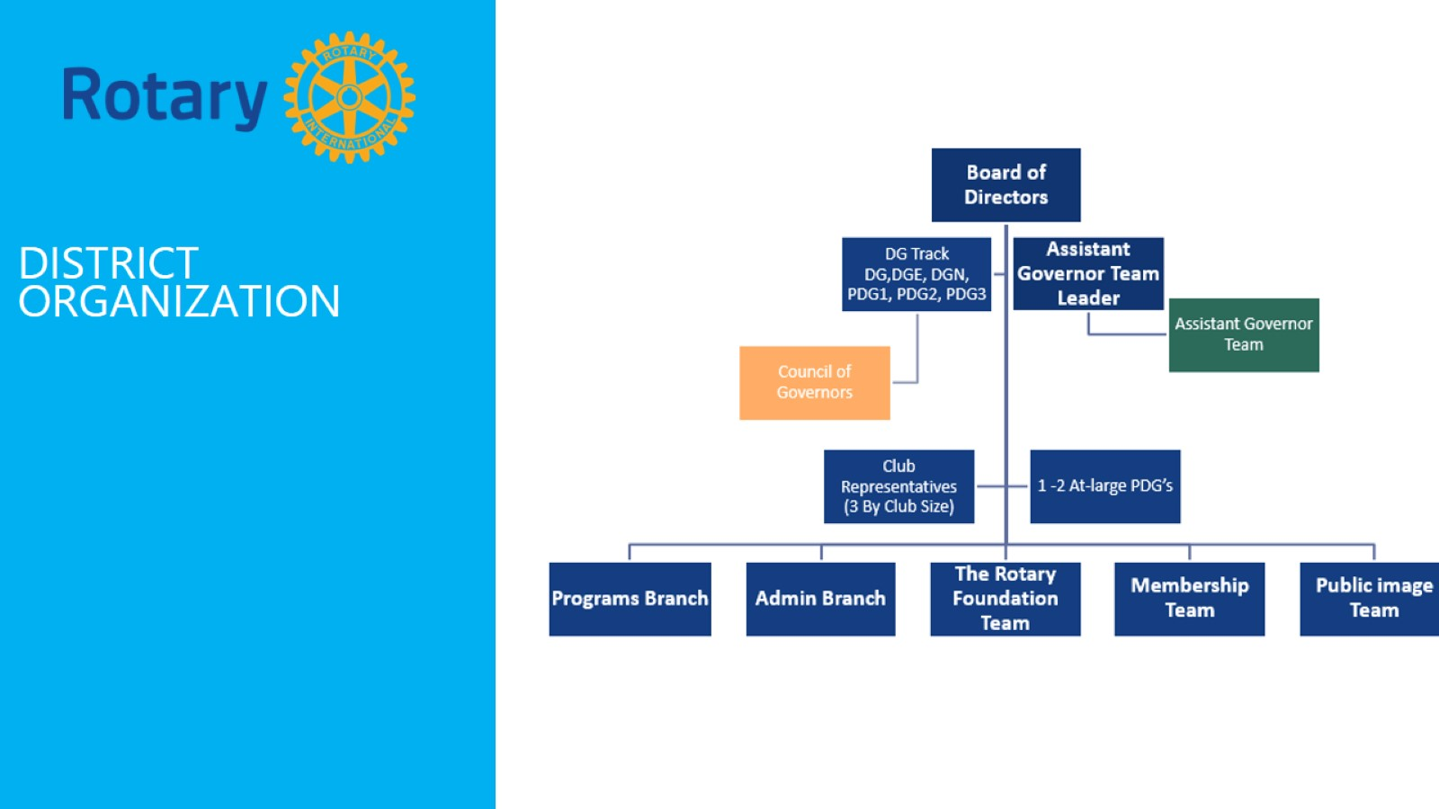

Slide 18
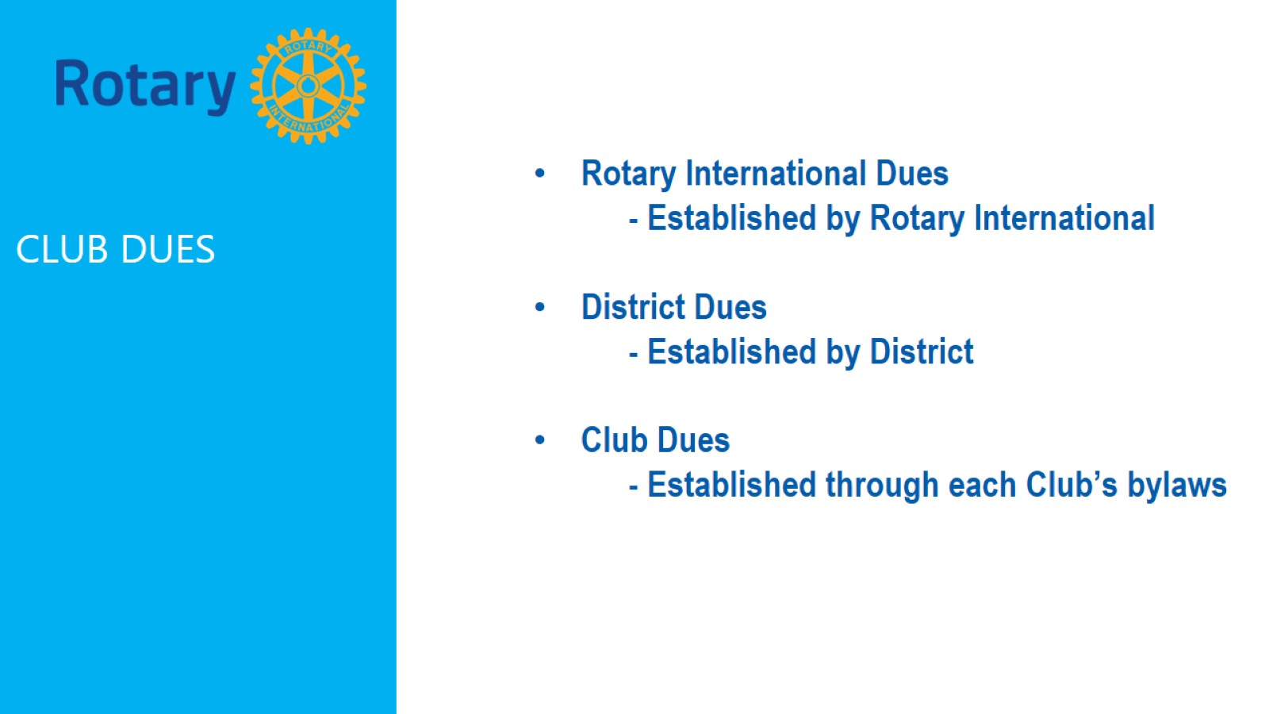

Slide 19
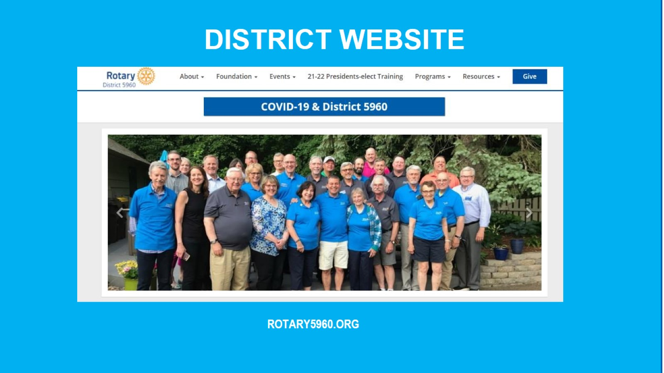

Slide 20
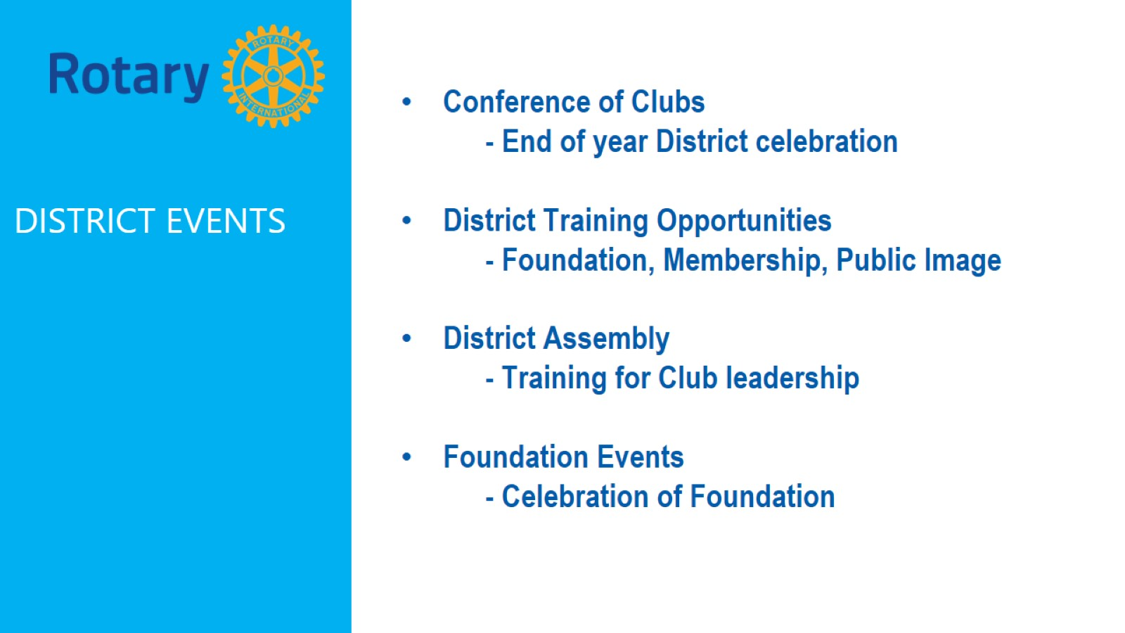

Slide 21
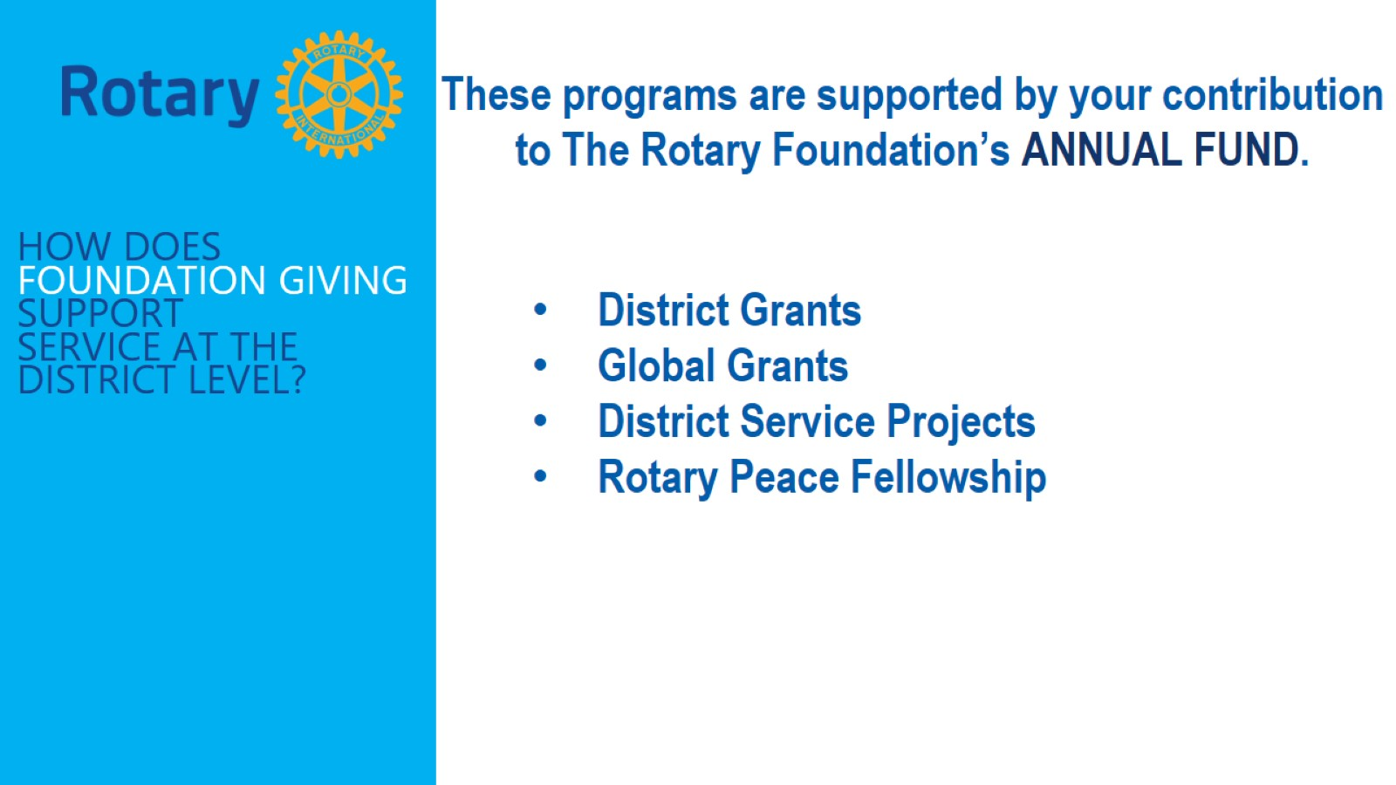

Slide 22


Slide 23
